Slide 1
Classification of reddit posts
Categories
Anger
Meditation
By – Vidhu Jain
GA – DSI – 10

Slide 2
Problem Statement
- A firm ABC Consultancy services offers various consultancy services. As part of marketing strategy, the firm wants to - build a model that reads the posts of category - 'Anger' and 'Meditation' from reddit - able to classify the category to which the post belongs - Using the prediction can offer Anger Management or Meditation Session services as part of marketing/ consultancy services - For this we need to build and train the model so that model can correctly classify the posts and enable the firm to run business model

Slide 3
Approach Used
- Web scrape reddit to collect posts for category - Anger, Meditation
- Make a dataset of combined posts
- Label categories as
- Anger - 1
- Meditation - 0
- From this dataset, randomly select 100 posts which will be used to test predictions on various model that will be used for modeling
- Save (on the disk as csv files) the big dataset for train/test purpose during modeling and sliced dataset as final test on model
- Read both dataset on do cleaning
- do train/test split
- consider only words by using regex
- lower case the characters in posts
- apply lemmatization
- clean the posts
- Use Count Vectorizer using stop-words(including 'Anger' and 'Meditation' and synonym words to these categories) to remove these words from features
- get the features list
- do this for train, test, final test dataset
- Train model on the vectorizer
- For predictions
- check for train/test score, final test score
- accuracy of validation set and final test set
- Compare and recommend the best model based on comparison

Slide 4
Word Cloud of category – Anger
Word cloud is before removing category related words from posts

Slide 5
Word Cloud of category – Meditation
Word cloud is before removing category related words from posts

Slide 6
Common high frequency words between two categories

Slide 7
Top 20 words from the bag of words after removing stop wrods – including category related words

Slide 8
Word Cloud of common words after cleaning posts

Slide 9
Modeling
Logistic Regression model using Lasso
Logistic Regression model using Ridge
Multi Nomial Naïve Bayes model
Random Forest

Slide 10
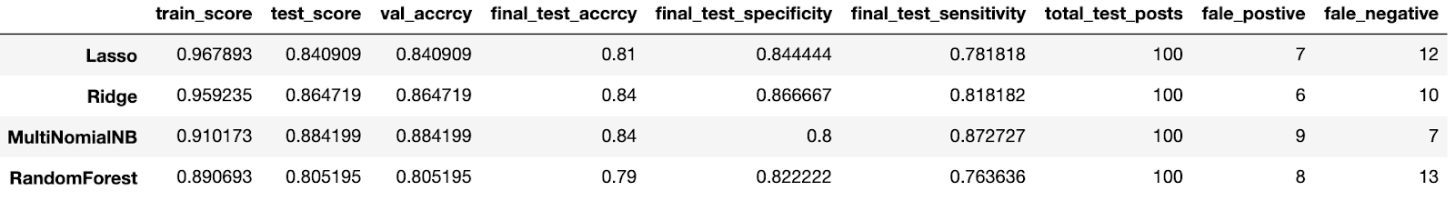
Comparison Matrix

Slide 11
Naive Bayes (Multinomial) Classification Model
Predicted Probability and ROC Curve with AUC on final Test Set

Slide 12
Comparison and Recommendation
- Have fit 4 models on reddit posts with two categories - Anger and Meditation labeled as 1 and 0
- Lasso Logistic Regression model
- Ridge Logistic Regression model
- Multinomial Naive Bayes model
- Random Forest model
- From above metrics it can be seen that Multi Nomial NB and Ridge Logistic Regression have good validation and accuracy score with final Test accuracy of 0.84
- Need more posts to train the model so that model can give good test accuracy and can be used for best predictions
- From above metrics Multi Nomial NB can be considered as best fit

